Slide 1
Introduction to Data Science

Slide 2

Table of Contents
Definition and scope
What, why and how?
Interdisciplinary nature; data science vs data analytics vs AI
Applications in business, healthcare, social sciences, and engineering

Slide 3
What is Data Science?
Data science is the study of data that helps us derive useful insight for business decision making. Data Science is all about using tools, techniques, and creativity to uncover insights hidden within data. It combines math, computer science, and domain expertise to tackle real-world challenges in a variety of fields.
It combines mathematics and statistics (for analysis), computer science (for computation and algorithms), and domain expertise (for problem understanding).
It is not just about analyzing past data but also about predicting future outcomes and supporting decision-making.
Data Science processes the raw data and solve business problems for better growth and achieving desired results.
Example: Netflix recommending movies, hospitals predicting patient risks, and banks detecting fraud.

Slide 4
Why Data Sciences?
The “Why” comes from its role in today’s digital and data-driven world:
Explosion of Data: Every second, huge amounts of data are generated from social media, sensors, transactions, and IoT devices. Traditional methods cannot handle this scale.
Better Decision Making: Businesses and governments rely on evidence-based, data-driven decisions instead of intuition.
Innovation and Research: Data Science powers cutting-edge applications like self-driving cars, personalized medicine, climate modeling, and AI assistants.
Competitive Advantage: Companies that leverage data science outperform those that rely only on conventional methods.
In short, Data Science is the backbone of modern decision-making, automation, and AI.

Slide 5
How Data Science Works?
Data science involves these key steps:
Data Collection: Gathering raw data from various sources, such as databases, sensors, or user interactions.
Data Cleaning: Ensuring the data is accurate, complete, and ready for analysis.
Data Analysis: Applying statistical and computational methods to identify patterns, trends, or relationships.
Data Visualization: Creating charts, graphs, and dashboards to present findings clearly.
Decision-Making: Using insights to inform strategies, create solutions, or predict outcomes

Slide 6
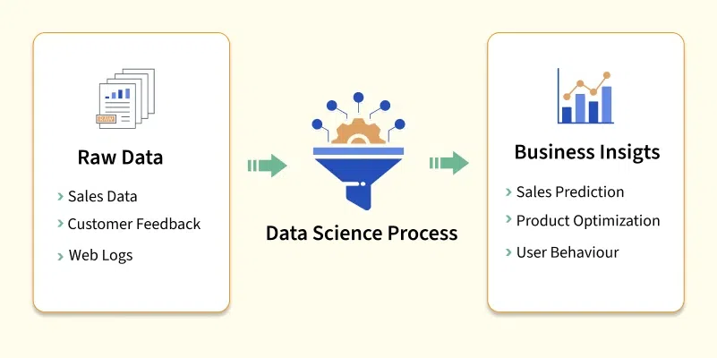

Slide 7
How Data Science Works?
Modeling – Apply machine learning or statistical models to detect patterns, make predictions, or classify data.
Evaluation – Validate models using accuracy, precision, recall, or error metrics depending on the problem.
Deployment – Integrate the solution into business or research systems for practical use.
Monitoring & Feedback – Continuously track performance and improve the model as new data becomes available.

Slide 8
Why Is Data Science Important?
In a world flooded with user-data, data science is crucial for driving progress and innovation in every industry. Here are some key reasons why it is so important:
Helps Business in Decision-Making: By analyzing data, businesses can understand trends and make informed choices that reduce risks and maximize profits.
Improves Efficiency: Organizations can use data science to identify areas where they can save time and resources.
Personalizes Experiences: Data science helps create customized recommendations and offers that improve customer satisfaction.

Slide 9
Why Is Data Science Important?
Predicts the Future: Businesses can use data to forecast trends, demand, and other important factors.
Drives Innovation: New ideas and products often come from insights discovered through data science.
Benefits Society: Data science improves public services like healthcare, education, and transportation by helping allocate resources more effectively.

Slide 10
Real Life Example of Data Science
There are lot of examples you can observe around yourself, where data science is being used. For Example - Social Media, Medical, Preparing strategy for Cricket or FIFA by analyzing past matches. Here are some more real-life examples:
Social Media Recommendation:
Have you ever wondered why you always get Instagram Reels aligned towards your interest? These platforms uses data-science to Analyze your past interest/data (Like, Comments, watch etc) and create personalized recommendation to serve content that matches your interests.

Slide 11
Real Life Examples of Data Science
Early Diagnosis of Disease:
Data Science can predicts the risk of conditions like diabetes or heart disease, by analyzing a patient’s medical records and lifestyle habits. This allows doctors to act early and improve lives. In Future, it can help doctors detect diseases before symptoms even start to appear. For example, predicting a Tumor or Cancer at a very early stage. Data Science uses medical history and Image-data for such prediction.
E-commerce recommendation and Demand Forecast:
E-commerce platforms like Amazon or Flipkart use data science to enhance the shopping experience. By analyzing your browsing history, purchase behavior, and search patterns, they recommend products based on your preferences. It can also help in predicting demand for products by studying past sales trends, seasonal patterns etc.

Slide 12
Industry where data science is used.
Data science is transforming every industry by unlocking the power of data. Here are some key sectors where data science plays a vital role:
  Healthcare: Data science improves patient outcomes by using predictive analytics to detect diseases early, creating personalized treatment plans and optimizing hospital operations for efficiency.
  Finance: Data science helps detect fraudulent activities, assess and manage financial risks, and provide tailored financial solutions to customers.
  Retail: Data science enhances customer experiences by delivering targeted marketing campaigns, optimizing inventory management, and forecasting sales trends accurately.

Slide 13
Industry where data science is used.
Transportation: Data science optimizes travel routes, manages vehicle fleets effectively, and enhances traffic management systems for smoother journeys.
Manufacturing: Data science predicts potential equipment failures, streamlines supply chain processes, and improves production efficiency through data-driven decisions.
Energy: Data science forecasts energy demand, optimizes energy consumption, and facilitates the integration of renewable energy resources.
Agriculture: Data science drives precision farming practices by monitoring crop health, managing resources efficiently, and boosting agricultural yields.

Slide 14
Important Data Science Skills
Data Scientists need a mix of technical and soft skills to excel in this domain. To start with data science, it's important to learn the basics like Mathematics and Basic programming skills. Here are some essential skills for a successful career in data science:
Programming: Proficiency in programming languages like Python, R, or SQL is crucial for analyzing and processing data effectively.
Statistics and Mathematics: A strong foundation in statistics and linear algebra helps in understanding data patterns and building predictive models.
Machine Learning: Knowledge of machine learning algorithms and frameworks is key to creating intelligent data-driven solutions.

Slide 15
Important Data Science Skills
Data Visualization: The ability to present data insights through tools like Tableau, Power BI, or Matplotlib ensures findings are clear and actionable.
Data Wrangling: Skills in cleaning, transforming, and preparing raw data for analysis are vital for maintaining data quality.
Big Data Tools: Familiarity with tools like Hadoop, Spark, or cloud platforms helps in handling large datasets efficiently.
Critical Thinking: Analytical skills to interpret data and solve problems creatively are essential for uncovering actionable insights.
Communication: The ability to explain complex data findings in simple terms to stakeholders is a valuable asset.

Slide 16
Jobs and Career in Data Science
1. Data Scientist
Responsibilities: Analyzing large datasets, developing machine learning models, interpreting results, and providing insights to inform business decisions.
Skills: Proficiency in programming languages like Python or R, expertise in statistics and machine learning algorithms, data visualization skills, and domain knowledge in the relevant industry.
2. Data Analyst
Responsibilities: Collecting, cleaning, and analyzing data to identify trends, patterns, and insights. Often involves creating reports and dashboards to communicate findings to stakeholders.
Skills: Strong proficiency in SQL for data querying, experience with data visualization tools like Tableau or Power BI, basic statistical knowledge, and familiarity with Excel or Google Sheets.

Slide 17
Jobs and Career in Data Science
3. Machine Learning Engineer
Responsibilities: Building and deploying machine learning models at scale, optimizing model performance, and integrating them into production systems.
Skills: Proficiency in programming languages like Python or Java, experience with machine learning frameworks like TensorFlow or PyTorch, knowledge of cloud platforms like AWS or Azure, and software engineering skills for developing scalable solutions.
4. Data Engineer
Responsibilities: Designing and building data pipelines to collect, transform, and store large volumes of data. Ensuring data quality, reliability, and scalability.
Skills: Expertise in database systems like SQL and NoSQL, proficiency in programming languages like Python or Java, experience with big data technologies like Hadoop or Spark, and knowledge of data warehousing concepts.

Slide 18
Jobs and Career in Data Science
5. Business Intelligence (BI) Analyst
Responsibilities: Gathering requirements from business stakeholders, designing and developing BI reports and dashboards, and providing data-driven insights to support strategic decision-making.
Skills: Proficiency in BI tools like Tableau, Power BI, or Looker, strong SQL skills for data querying, understanding of data visualization principles, and ability to translate business needs into technical solutions.
6. Data Architect
Responsibilities: Designing the overall structure of data systems, including databases, data lakes, and data warehouses. Defining data models, schemas, and data governance policies.
Skills: Deep understanding of database technologies and architectures, experience with data modeling tools like ERWin or Visio, knowledge of data integration techniques, and familiarity with data security and compliance regulations.

Slide 19
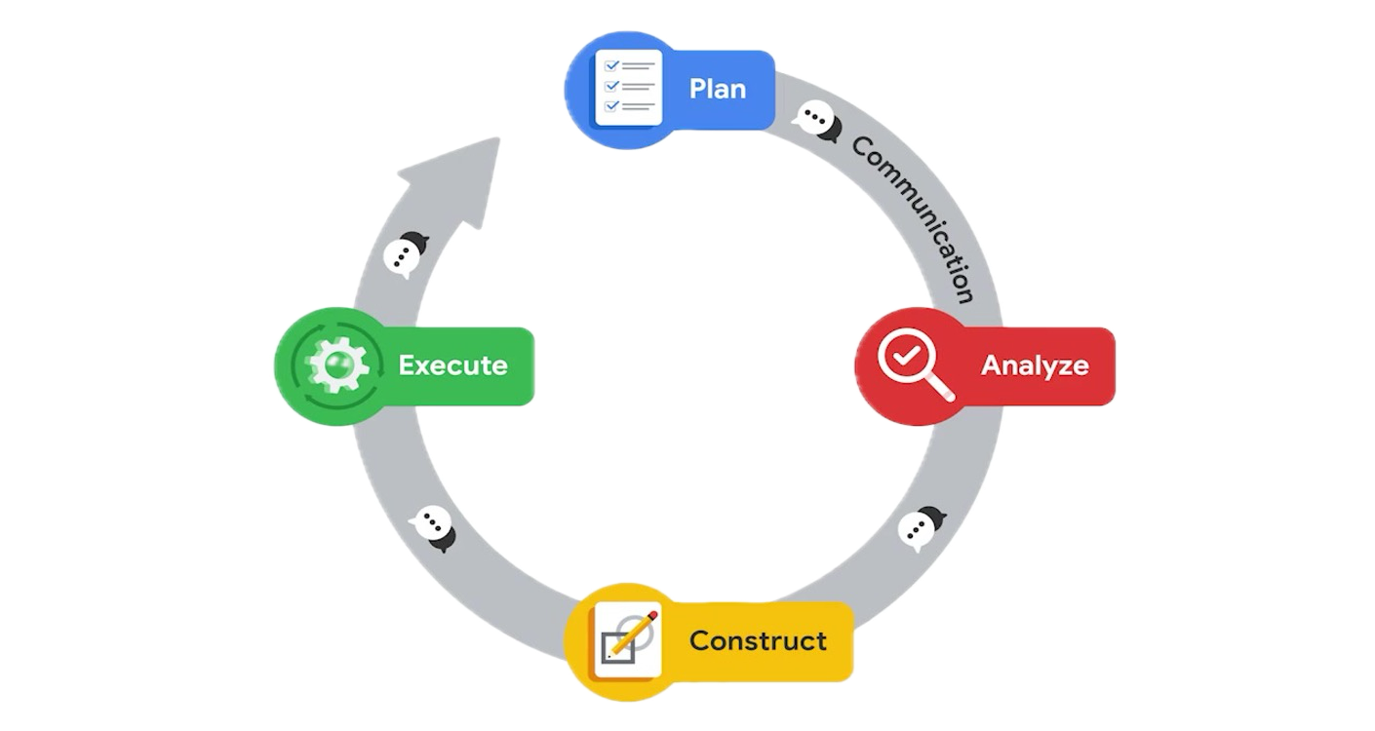
Data Science Life Cycle

