Slide 1
Understanding Data Types & Sources: Structured, Semi-Structured, Unstructured, and Beyond

Slide 2

Table of Contents
Data Types: Structured, Semi-structured, Unstructured
Data Formats: Text, Image, Audio, Video
Open Data Sources Overview
Wide data and long data
Databases: Foundations of Data Storage
Practical Examples & Platforms
Summary & Next Steps

Slide 3
How is Data collected?
Interviews
Observations
Forms
Questionnaires
Surveys
Cookies

Slide 4
Data Collection Considerations
How the data will be collected?
Choose data sources.
Decide what data to use
Select the right data type
Determine the time frame
First Party Data
Data collected by an individual or group using their own resources.
Second Party Data
Data collected by a group directly from its audience and then sold.
Third Party Data
Data collected from outside sources who did not collect it directly.

Slide 5
How much data must be collected?
Population
All possible data values in a certain dataset
Sample
A part of a population that is representative of the population.

Slide 6
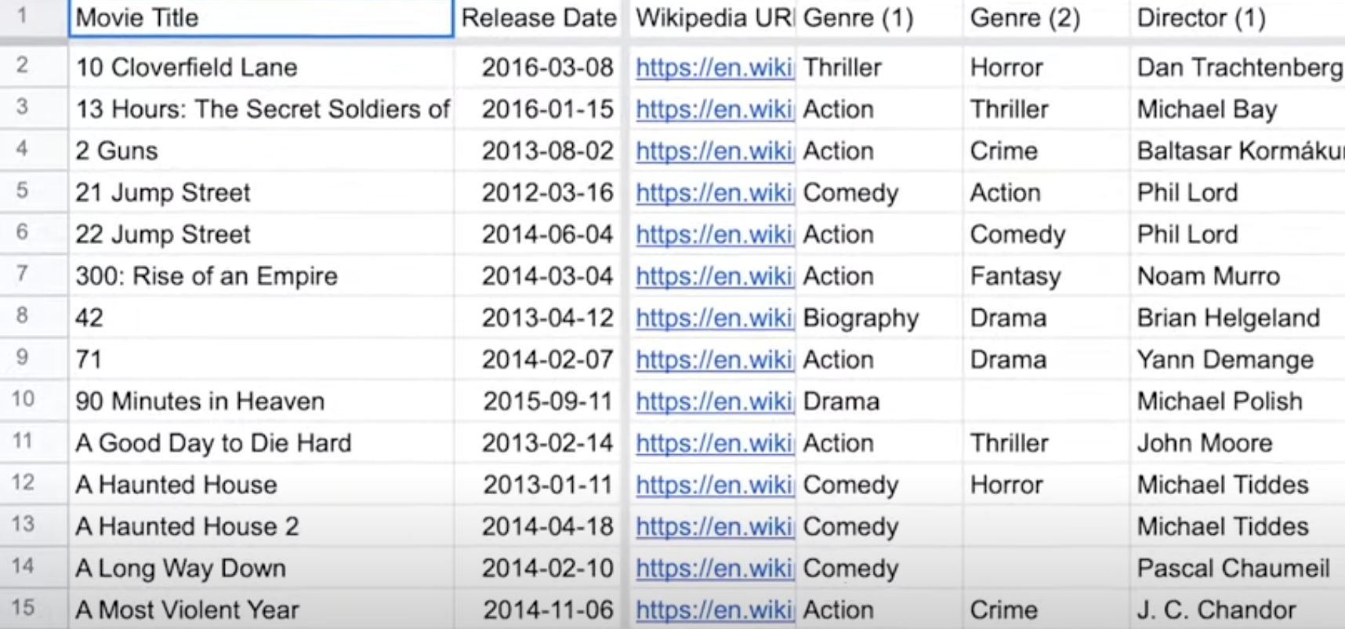
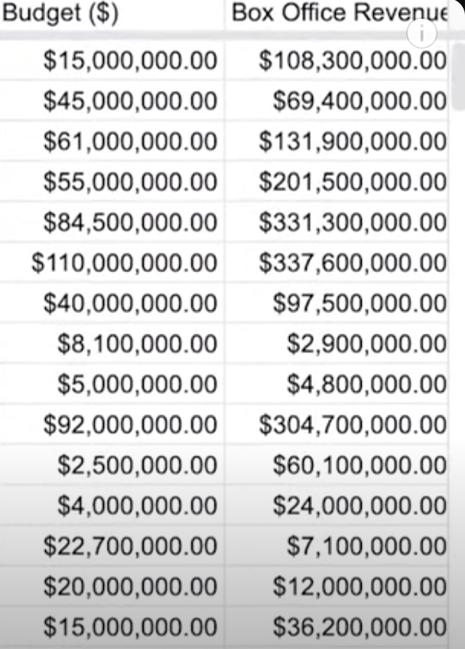
Qualitative & Quantitative Data

Slide 7
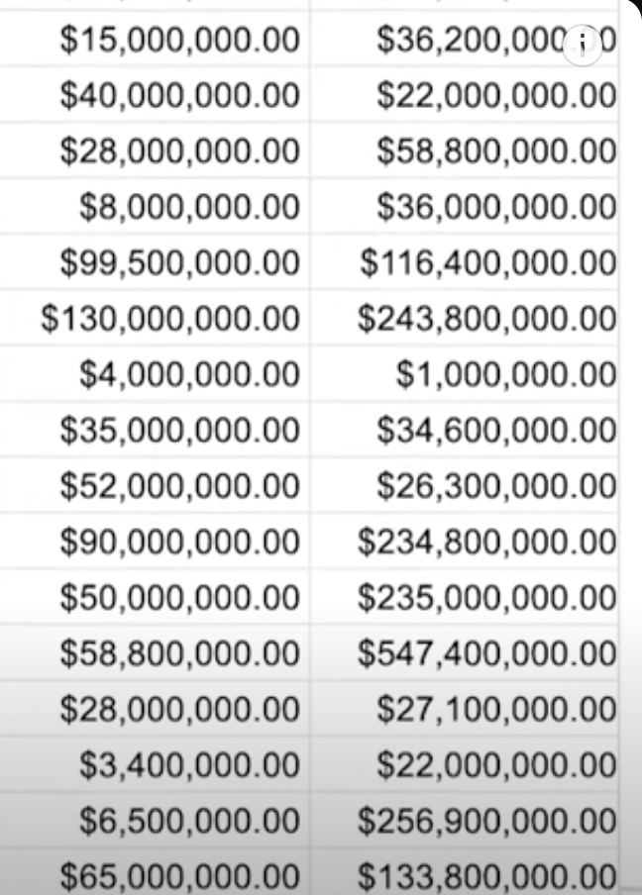
Discrete Data
Data that is counted and has a limited number of values.
Continuous Data
Data that is measured and can have almost any numeric value

Slide 8

Nominal Data
A type of qualitative data that is categorized without an order. (Doesn't have a sequence, not sure)
Ordinal Data
A type of qualitative data with a set order or scale. (rank a movie from 1 to 5)
Internal Data
A data that lives within a company’s own system
External Data
Data that lives and is generated outside of an organization.

Slide 9
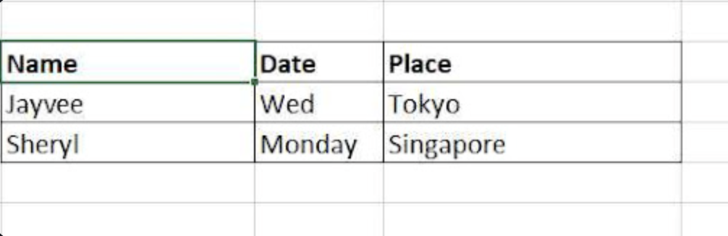
Structured Data
Structured data is highly organized in fixed fields within records or files, fitting neatly into predefined schemas. Think of traditional tables with rows and columns.
Examples include customer records in a CRM, financial transactions in an accounting system, or sensor logs from IoT devices.
Its rigid format allows for easy querying with SQL and ensures strong schema enforcement, making it the bedrock of traditional business intelligence and analytics.

Slide 10
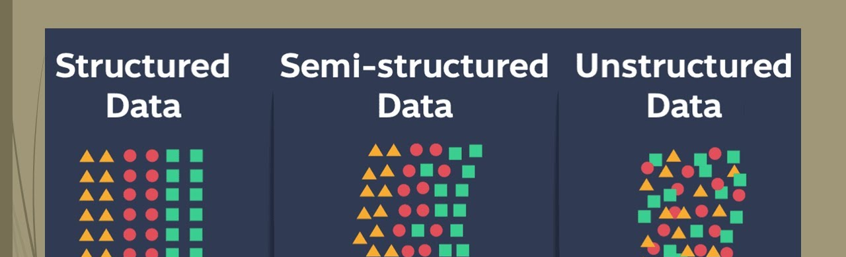
Semi-Structured Data
Semi-structured data contains tags or markers to separate semantic elements but lacks a rigid schema. It doesn't conform to the formal structure of relational databases but isn't entirely raw either.
Common examples are JSON, XML, and YAML files, often used in web APIs and configuration.
NoSQL document stores like MongoDB thrive on this flexibility, allowing for evolving data models and nested data structures.
It bridges the gap between structured and unstructured data, ideal for modern applications requiring agility.

Slide 11
Unstructured Data
No Predefined Model
Unstructured data has no predefined data model or organization. It's raw and doesn't fit into conventional rows and columns.
Diverse Examples
This includes emails, social media posts, images, audio files, and video content.
Dominant Volume
It represents approximately 80% of enterprise data volume today, and this percentage continues to grow.
Advanced Processing
Analyzing unstructured data requires advanced techniques like Natural Language Processing (NLP), computer vision, and speech recognition.

Slide 12
Data Formats: Text, Image, Audio, Video
Text Data
Encompasses everything from documents and logs to social media feeds and chatbot interactions. Analyzed using Natural Language Processing (NLP) for sentiment analysis, entity extraction, and more.
Image Data
Includes formats like JPEG, PNG, and specialized medical scans (e.g., X-rays). Processed with computer vision and image recognition for object detection, facial recognition, and diagnostic assistance.
Audio Data
Covers podcasts, voice assistants, and call recordings. Utilizes speech-to-text conversion and advanced audio analysis for insights into tone, emotion, and content.
Video Data
Analyzed using video analytics for motion detection, activity recognition, and content moderation.

Slide 13
Data collection considerations
How the data will be collected
Choose data sources
Decide what data to use
How much data to collect
Select the right data type
Determine the time frame

Slide 14
Wide Data & Long Data
Wide data refers to data where each subject or observation is represented in a single row, and each variable or repeated measurement is stored in a separate column.
Long data represents each observation (measurement, condition, or time) as a separate row, with columns identifying variables like subject, variable type, and value.

Slide 15
Wide Data
Student | Math_2023 | Math_2024 | Science_2023 | Science_2024
Ali | 85 | 90 | 88 | 91
Sara | 78 | 82 | 84 | 87
Long Data
Student | Subject | Year | Score
Ali | Math | 2023 | 85
Ali | Math | 2024 | 90
Sara | Science | 2023 | 84
Sara | Science | 2024 | 87

Slide 16
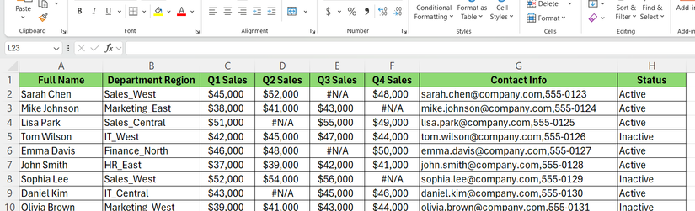
Complex Datasets
A complex data set is a collection of data that goes beyond simple tabular values (like rows and columns in Excel). These sets are usually large, varied, interconnected, and may include multiple data formats or structures. They often require specialized tools or techniques for storage, processing, and analysis.

Slide 17
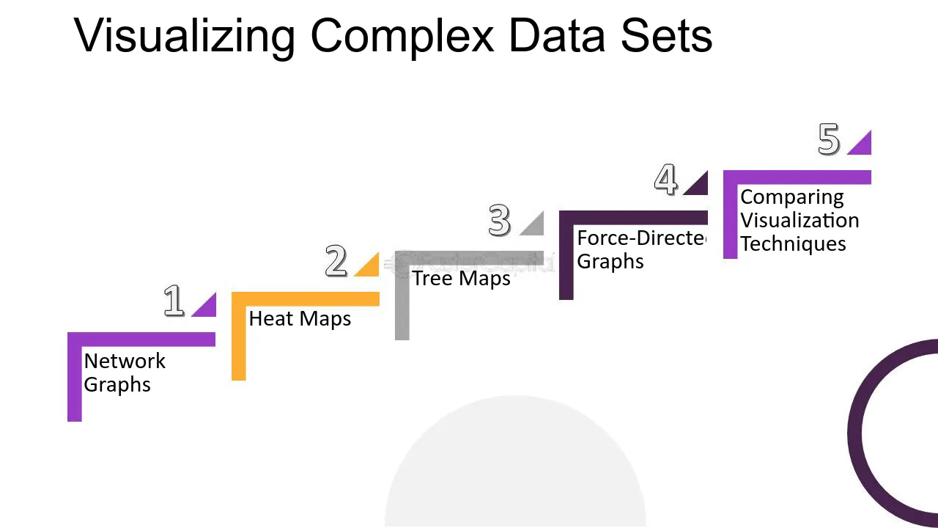
Visualizing Complex Datasets

Slide 18
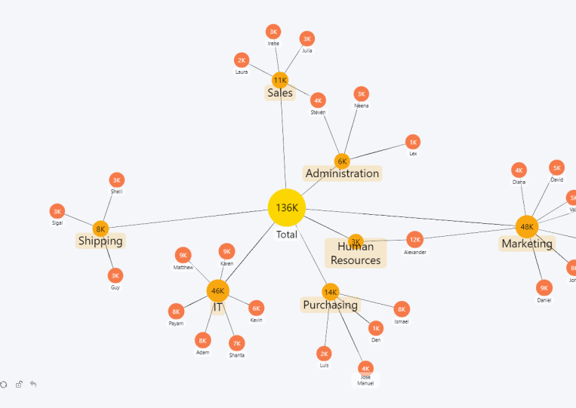
Network Graphs

Slide 19
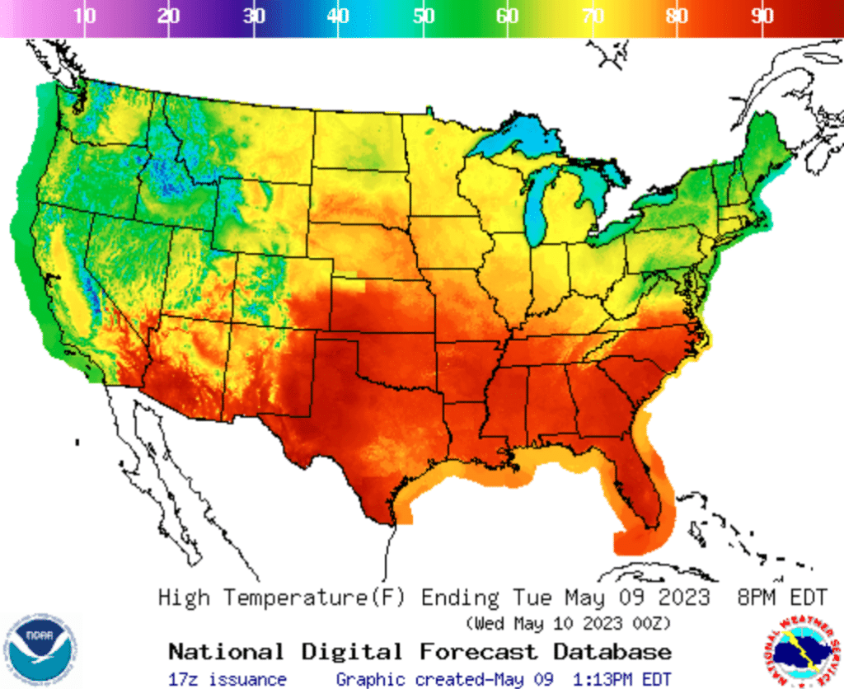
Heat Map

Slide 20
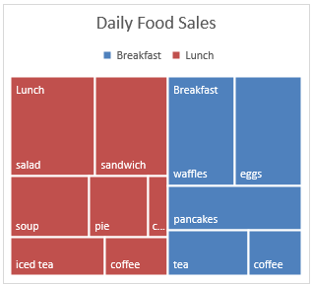
Tree Map

Slide 21
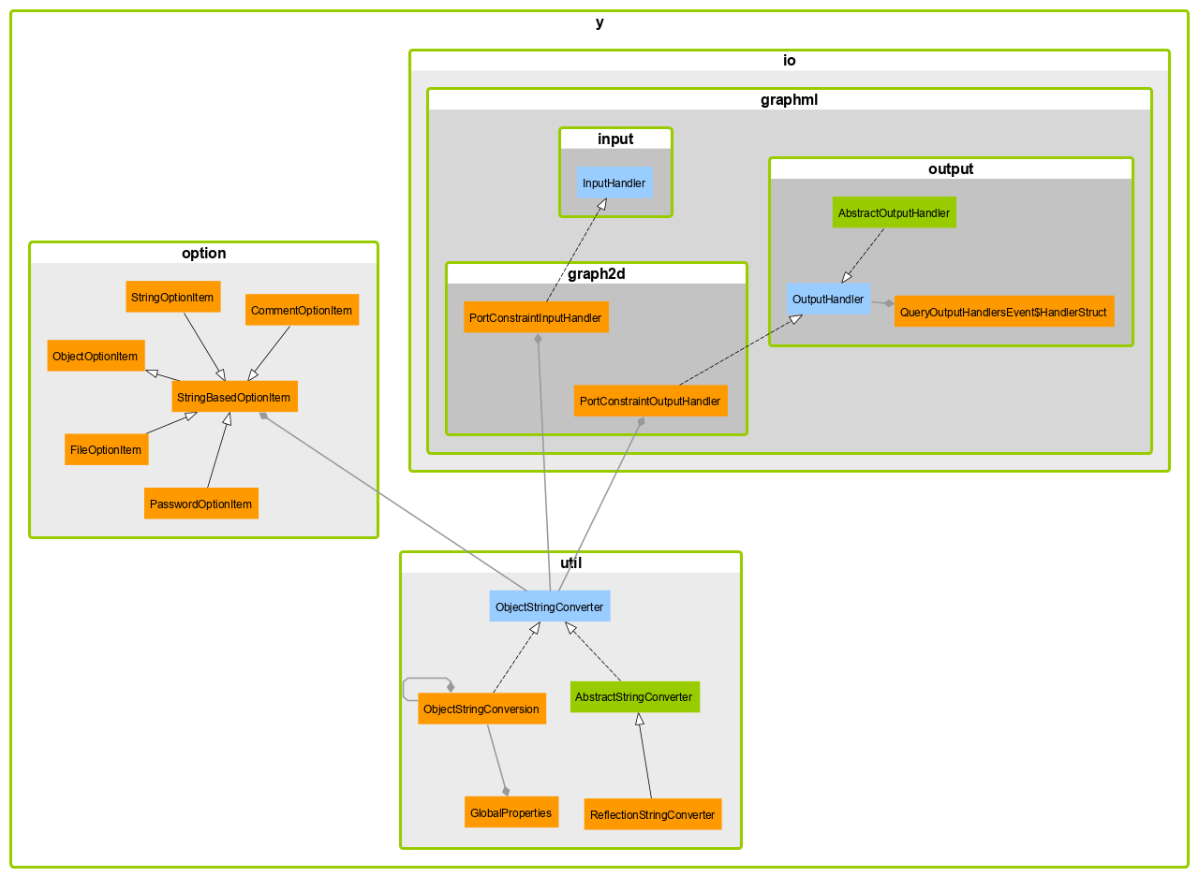
Force Directed Graph

Slide 22
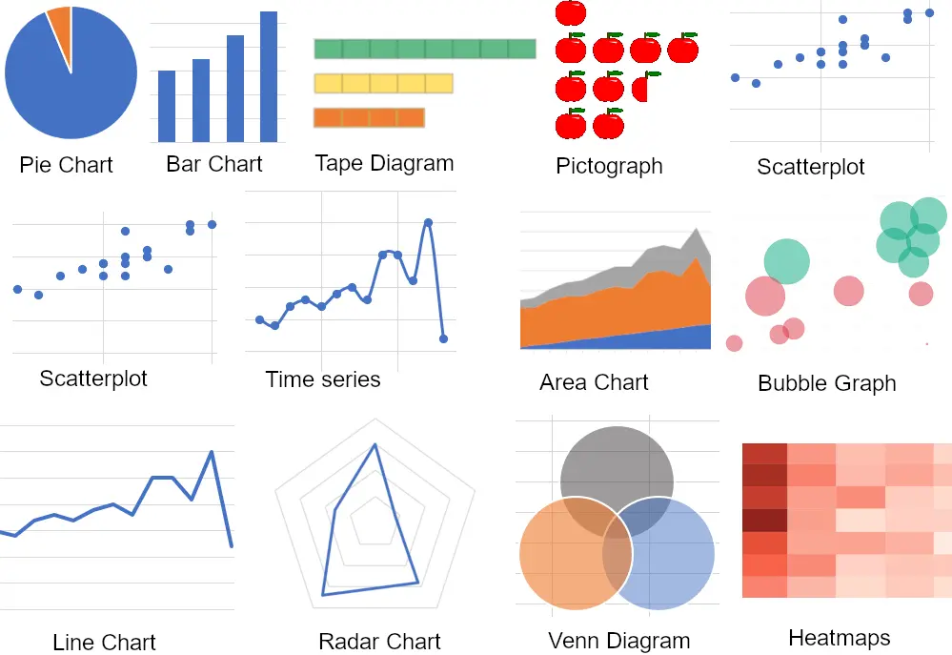

Slide 23

Class Activity
Download a dataset from Kaggle (for example: movie rating dataset, or any dataset of your choice). Perform the following tasks in Python:
Import the dataset into a Pandas DataFrame.
Display the first 10 rows and basic information (column names, data types, shape).
Perform basic data cleaning (handle missing values, drop duplicates if any).
Generate descriptive statistics for numerical and categorical columns.
Create at least three visualizations using Matplotlib or Seaborn, such as:
Histogram for a numerical column.
Bar chart or count plot for a categorical column.
Scatter plot showing the relationship between two variables.
Write a short interpretation (2–3 sentences) of each visualization.
Perform the task on Google Colab.

